Slide 1


Adventitial Tissue Analysis
in Coronary Atherosclerosis
ATACA
Group 23
Sabrina Figueroa-Buezo, Adriana Guetter, Wei (Harrison) Li, Salil Patel, Daibo Zhang
Dr. Geert Schmid-Schönbein
Dr. Elliot McVeigh

Slide 2
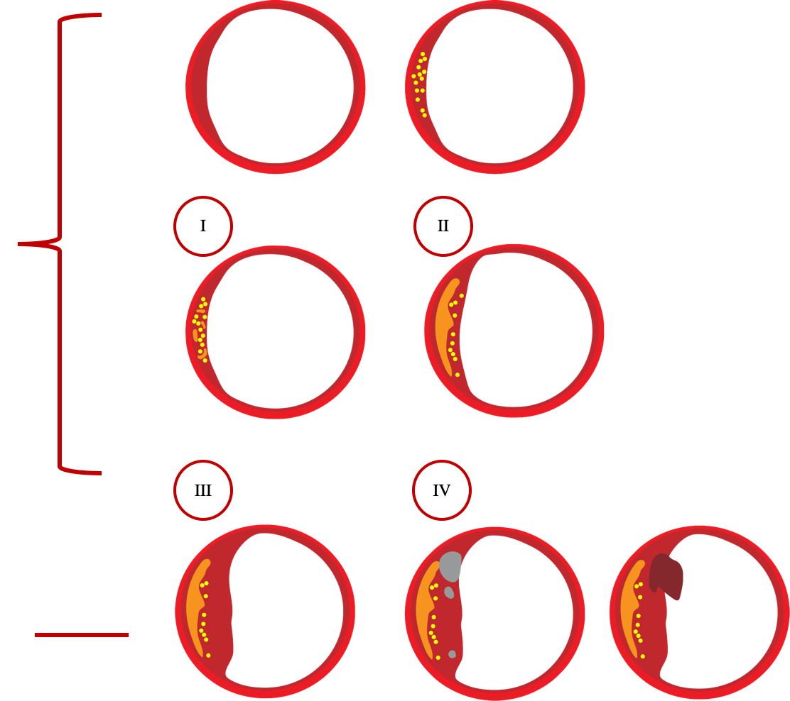
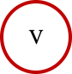
Background: Atherosclerosis Disease
Results from plaque build-up in the coronary arteries of the heart.
9.2 Million people/year are affected.
Easy to diagnose lesion types are:
-fat
-calcified
-thrombotic
Thickenning
(smooth muscle)
Macrophages
Clinically silent
Lipid pools
Lipid core
Clinically silent or overt
Lipid core (Fibroatheroma)
Fibroatheroma + Calcium
Fibroatheroma +
Thrombosis
Notes:
Atherosclerosis is a disease that contributes to 1 of every 3 deaths in the U.S and it can lead to a multitude of potentially life-threatening conditions. This progressive disease arises due to the formation of plaques composed of calcium, cholesterol, fatty materials, cell debris, and fibrous tissue on the inner walls of the vascular system. The majority of plaque deposits occur in the arteries, although lesions could also occur in the veins.
Atherosclerosis initiation is characterized by the thickening of the intimal layer of arteries as and accumulation of fat, shown in the diagram under I and type II.
The accumulation of fat progresses to atheroma, where the growth of plaque disrupts blood flow and causes shear stress in the vessels and eventually vascular wall damage. The disease might progress into forming a calcification and even rupture and become a thrombotic lesion as shown at the bottom of the diagram.
Considering the mechanism of plaque initiation, atherosclerosis can best be described as an inflammatory and progressive process that is strongly linked to lipid oxidation,¹⁶ as well as diseases including diabetes and high blood pressure.

Slide 3
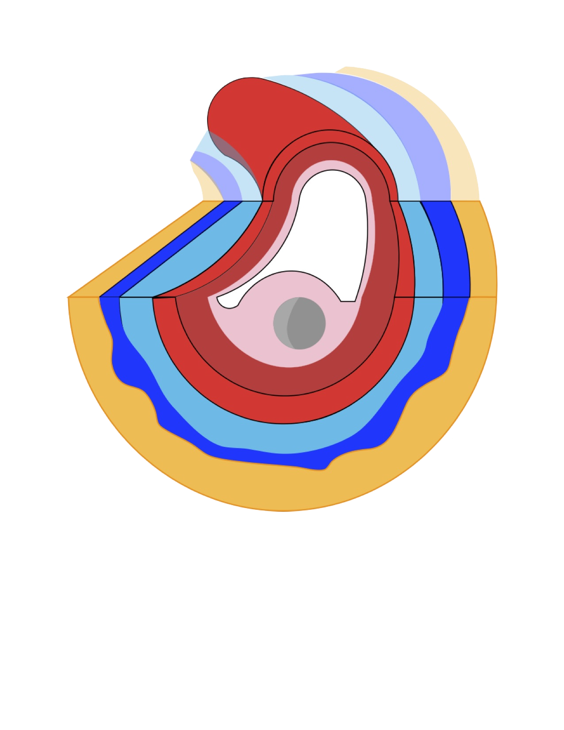
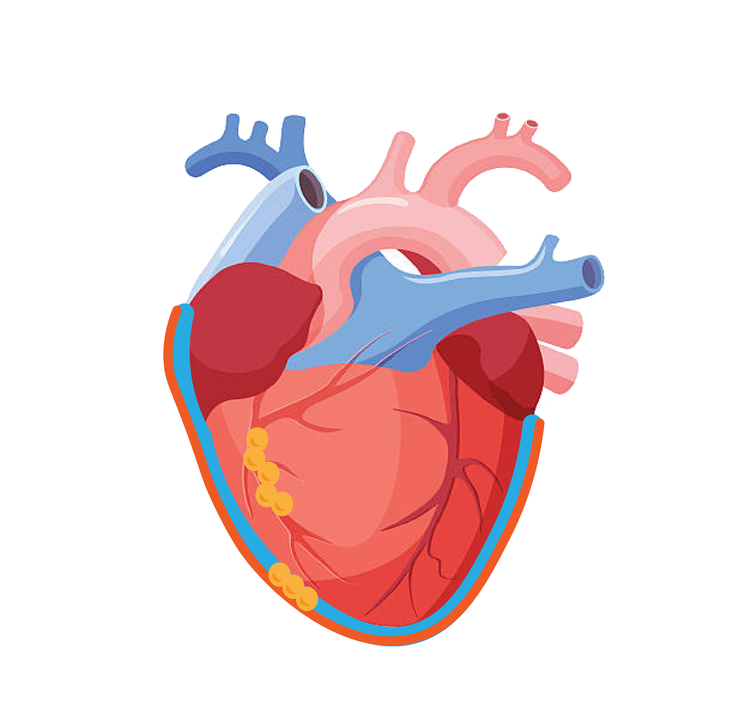
Background: Calcium Lesions
Clinical
Indicator of coronary artery disease.
Diagnosis possible by different imaging modalities.
Prognosis of atherosclerotic patients
Non-clinical
Theories of Etiology of Atherosclerosis
Morphological study of atherosclerotic lesions
Trends/patterns in Atherosclerotic patients
Coronary Vessel + Adventitial Tissue
Fat/ Connective Tissue
Calcified Lesion
Epicardium
Pericardium
Epicardial Fat
Notes:
A great indicator for atherosclerosis diagnosis and prognosis is coronary artery calcium.
Currently, CAC formation is understood as an active biological process with systematic and coordinated cellular actions instead of the passive deposition of calcium.
Studies of the biochemical composition of CAC plaques have uncovered the involvement of calcification-related and are specultated to be a protective mechanism initiated by injured vascular cells to stabilize plaques and prevent progression of the disease. This speculation requires researchers to identify the surrounding tissue of these lesions also known as the epicardium. The epicardium might contain a percentage of fat which would support this theory. As more fat correlates with an autoimmune response which might lead to calcified lesions.
For this reason, understanding the geometry and morphological features of the coronary vessels with caclcified atherosclerotic lesions, fat lesions, and healthy vessels becomes essential when diving into the research of the etiology of the disease.

Slide 4
Problem Statement
The etiology of atherosclerosis is controversial:
Genetics
Viruses, bacteria
Fluid shear stress & arterial bifurcations.
Inflammation and cholesterol related to diet
Progression of atherosclerotic lesions
Morphology of atherosclerosis
Adventitial tissue in atherosclerotic lesions
Current pathological and imaging studies of atherosclerosis in humans omit critical anatomical information of surrounding tissue that can shed light on the initiation of atherosclerosis.
Notes:
However, the etiology is still uncertain, especially with respect to the specific location of early lesions in arteries and how these lesions progress. Moreover, the relationship between calcified lesions and adventitial tissue is sought to study the morphology and the origin of atherosclerosis.
The problem of unresolved etiology and morphology is a result of technical limitations in investigating early lesions. Only very recently, calcium deposits, an early sign of atherosclerosis, have been identified. As such, many studies regarding the pathogenesis of atherosclerosis use tissue biopsies and images of arteries with advanced atherosclerosis, which result in difficulties in studying the early-stage development of the disease.
This limitation is due to the lack of tools available for processing, analyzing and quantifying available data in imaging scans to address early lesions.

Slide 5
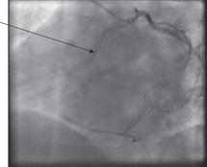
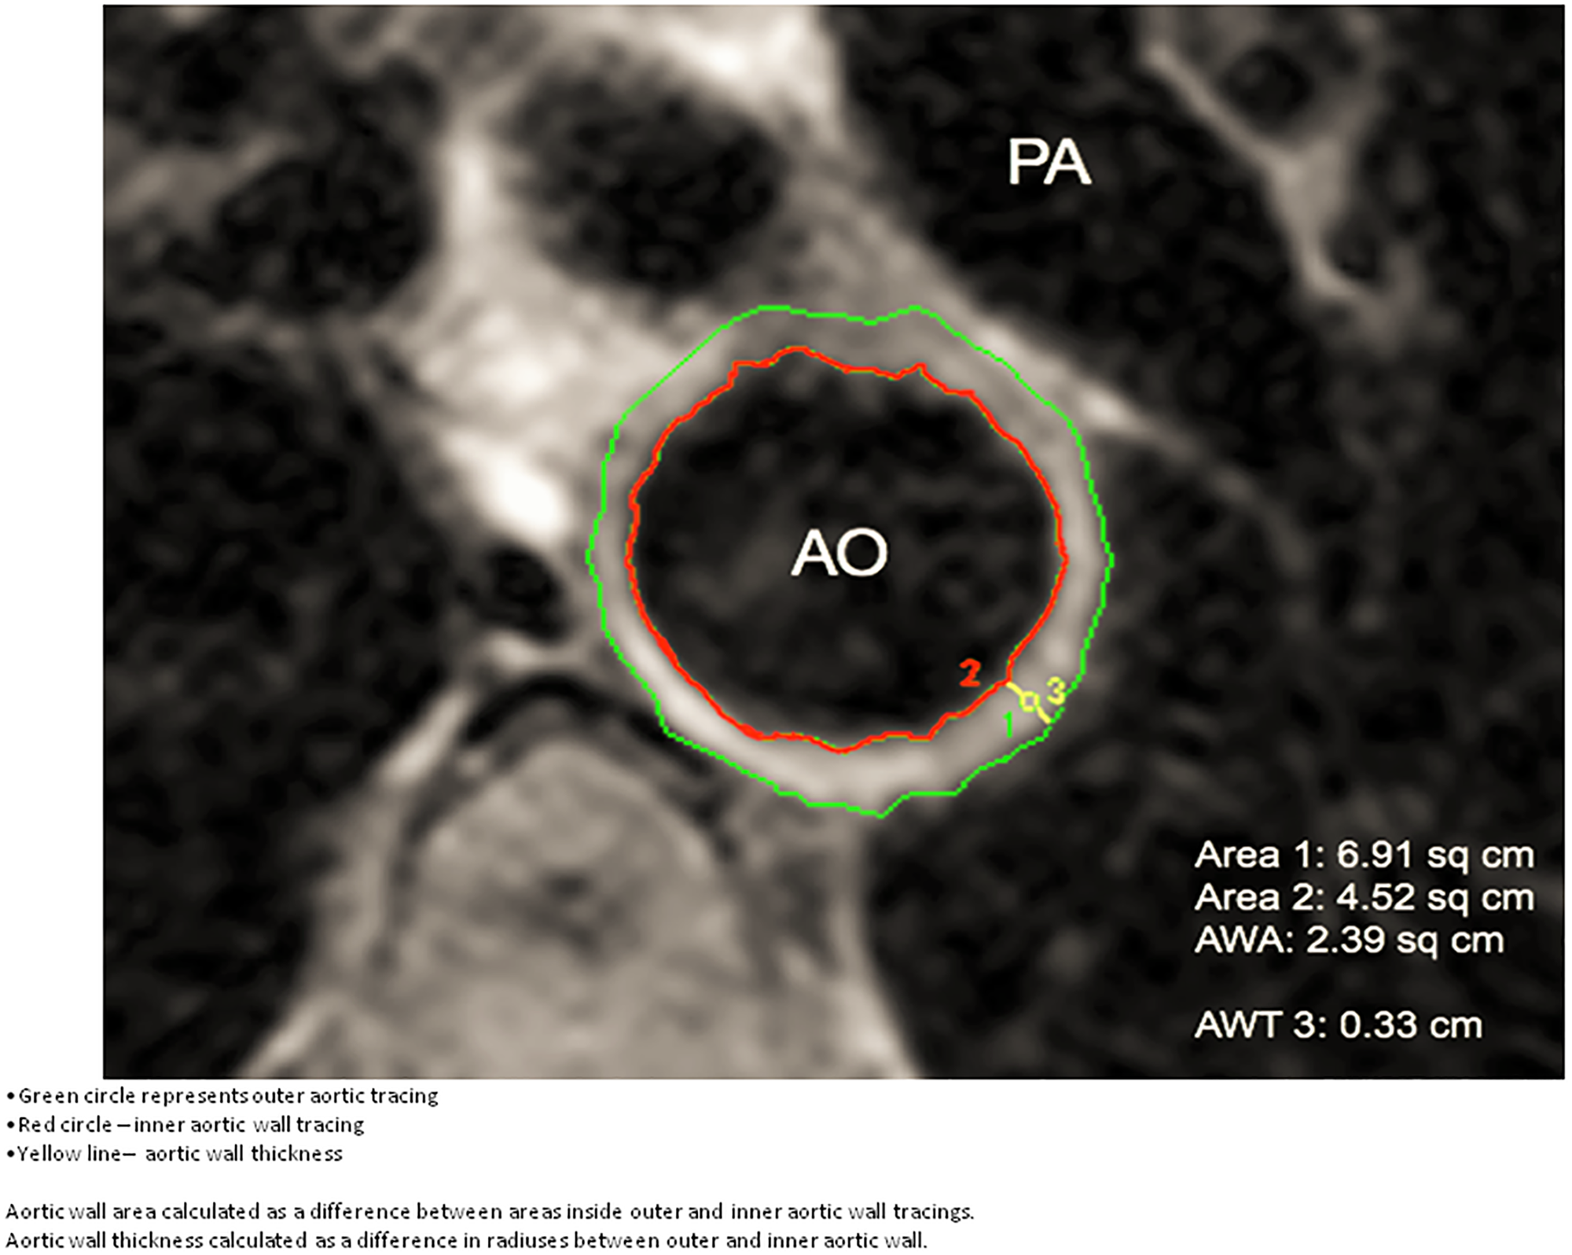
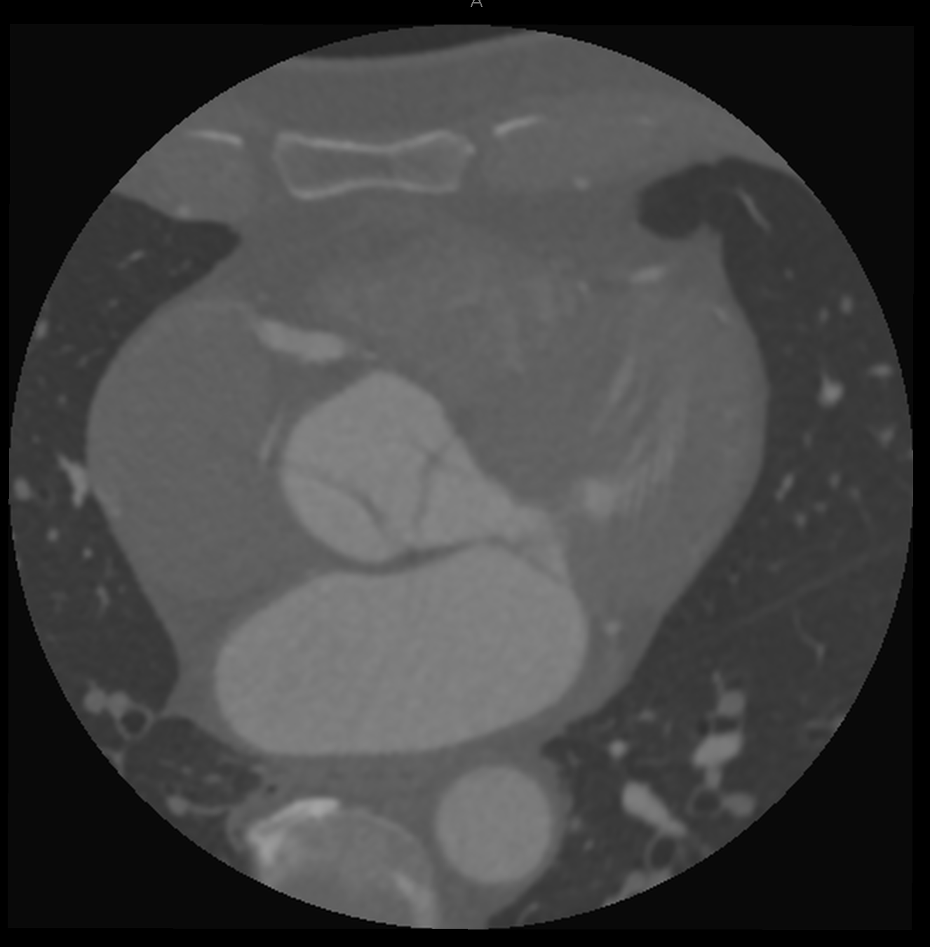
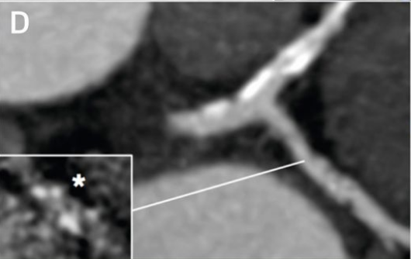
Current Technology: Non-Invasive Techniques
Chen. N, et. Al (2014). Resonance Imaging of the Coronary Sinus. Insights into Imaging
Imaging Modality | Coronary Angiography | CMR | CT-Scan | PET-Scan
Calcium | xx | x | xxx | x
Plaque Area | xxx | x | xx | x
Coronary vessel Anatomy | x | xx | xxx | -
Prakash, V. (2018). Computed Tomography Coronary Calcium Score and Coronary Angiography.
Chandy E. (2018). Systemic Involvement in ACS: Using CMR to study aortic wall.
Jason M (2017). Detection of Atherosclerotic Inflammation
Figure 1. Original CT-Scan obtained from Dr. E. McVeigh
Notes:
The imaging methods to diagnose atherosclerotic patients and study the disease include the ones shown in the following table. All of these methods have limitations and some might be better than others in particular cases.
For our design, we were lucky enough to have the opportunity to work with CT-Scans given that they provided a reasonable image resolution with all of the features to study the morphology of atherosclerotic lesions and vascularity in the heart.
A CT scan machine is able to combine a series of X-ray images taken from different angles around your body and use computer processing to create cross-sectional images of the blood vessels and any soft tissues inside your body, these cross sections are commonly called slices. CT scan images are able to provide more detail than an X-ray scan.
However, CT imaging still has two main issues that limit its clinical use in direct atherosclerotic monitoring: (1) radiation exposure and (2) plaque progression and patient prognosis do not correlate well with the information on plaques that could be obtained from a CT scan. This is due to the fact that mild plaque might not appear on a CT-Scan.

Slide 6
Objective & Goals for the Design
Goal : analyze tissues surrounding the coronary artery to help researchers verify theories about the etiology of atherosclerosis.
Main Objective: create a CT-scan processing tool for research and clinical studies of atherosclerotic lesions.
Objectives:
Reduce the need for human analysis of these images.
Provide the means for understanding adventitial tissue around atherosclerotic lesions.
Reduce the time for manual processing of CT-Scans when analyzing vessels.
Quantify adventitial tissue in a region of interest of the whole image.

Slide 7

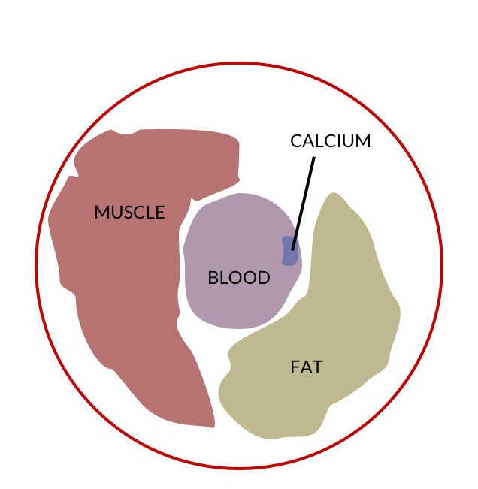
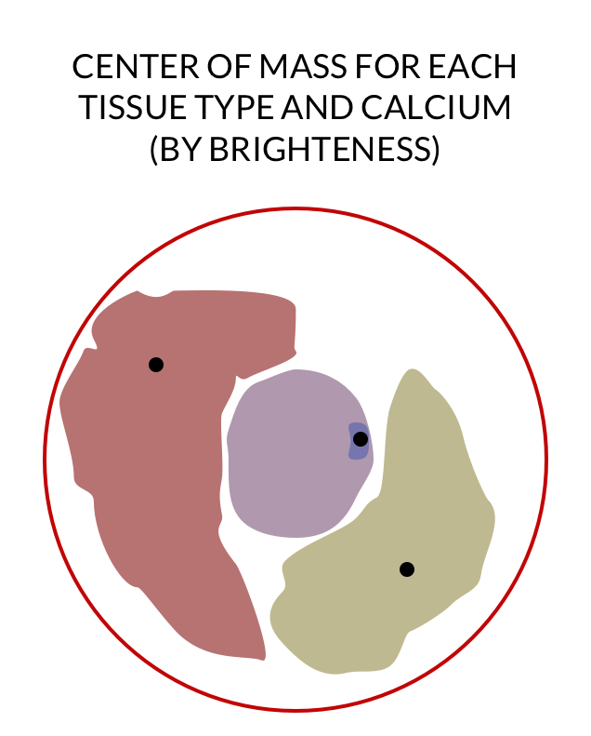

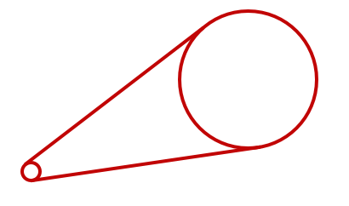

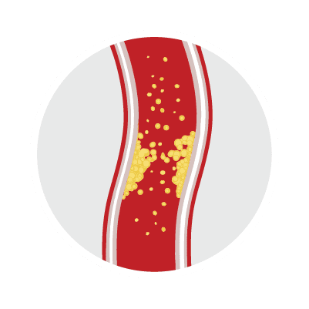

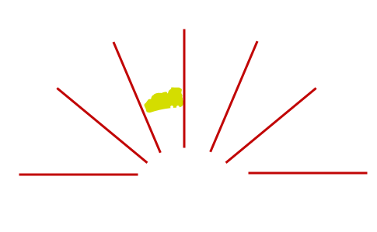


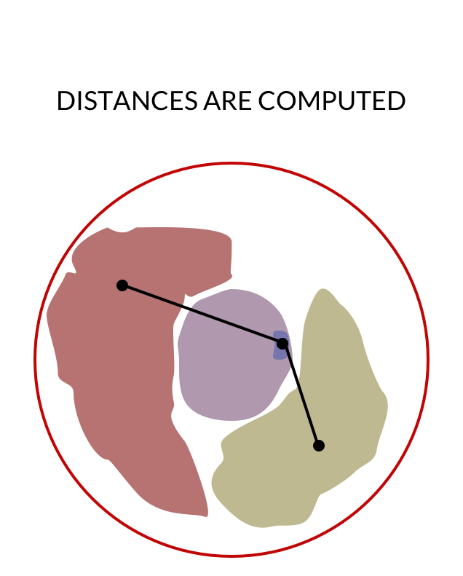
Our Design: Innovative Tool for Analysis
Segment vessel of interest
Determine
Centers of
Masses of
Different
Tissue
Output
Geometric
Distances
Characterize Surrounding Tissue
by Pixel Brightness
Linearize Vessel

Slide 8
Segment a section of the coronary artery using ITK-SNAP and store the output in an niFTI files.
Look for stenosis in coronary CT image
ITK-SNAP
Pre-processing
Import the segmented vessel into MATLAB, parameterize its centerline to linearize the vessel.
Import the CT image DICOM file into MATLAB as an indexed 3D Matrix <x,y,z>
MATLAB
Data conditioning
Extract the linearized vessel and its surrounding tissues from the CT image
Categorize the tissues surrounding the vessel and colorcode them based on type (e.g. fat, muscle)
MATLAB
Data parsing
Analyze the geometry of the tissues surrounding the vessel with length measurements and center of mass locations
Visualize the linearized vessel with surrounding tissues color coded by type
Analyze the distribution of different types of tissues surrounding the vessel
MATLAB
Analysis

Slide 9
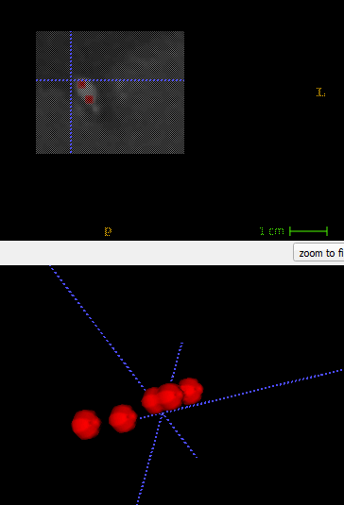
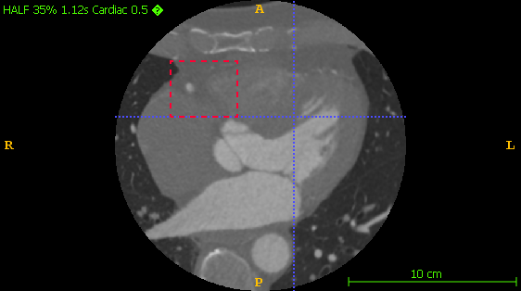
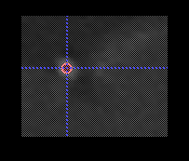
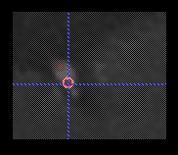
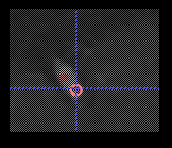
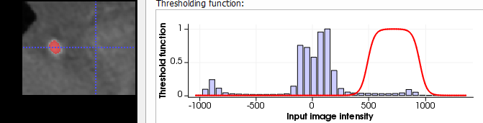
Vessel Segmentation in ITK-SNAP
ITK-SNAP
Pre
processing
Contour Evolution
Insert Seeds in Vessel to Capture
Select Region of Interest
Z slices
Threshold Intensities to Capture

Slide 10
Vessel Linearization
Pre
processing
MATLAB
Motivation:
Normalize segmented vessel
Allows different vessels to be compared to each other
Diminishes effects of differences between vessels such as curvature
Allows for a more intuitive way to view the progression of the vessel
Optimize computing efficiency
Reduces size of region of interest
Process:
Centerline Extraction
Tangent Vector Estimation
Normal Plane Calculation

Slide 11
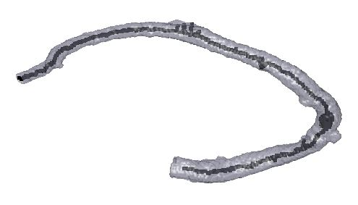
Vessel Linearization (Centerline Extraction)
Pre
processing
MATLAB
Obtain centerpoints along segmented vessel
Presents centerpoints and visual “Skeleton” of the segmented vessel
Some centerpoints may be bad and will have to be manually deleted
Code developed by Zhennong Chen, a member of Dr. McVeigh’s lab
Centerline Extraction of “Right Coronary to Marginal Branch” segmented vessel

Slide 12
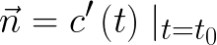
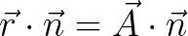
Vessel Linearization (Tangent Vector Estimation)
MATLAB
Pre
processing
Fit a Parametrized Curve c(t) for each Centerpoint
Define “Principal Direction” of vessel as “the direction (x,y,z) in which the vessel progresses the most”
Fit 2 polynomials (degree decided by user), where each “Dependent” coordinate is a function of the “Principle Direction” coordinate
Curve is fit with n points before and after centerpoint (total # of points = 2n+1)
Take Derivatives of Parametrized Curves and Evaluate Derivatives at Centerpoint
The resulting vectors are the estimated tangent vectors ( )
General Case in 3D:

Slide 13
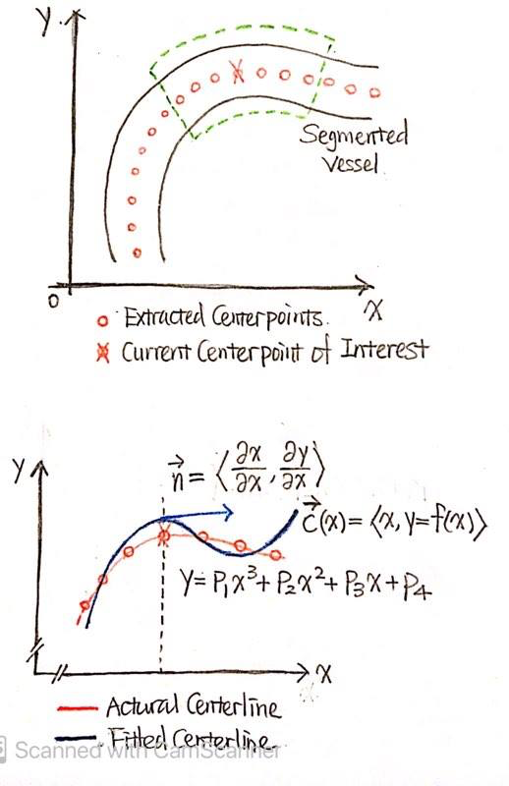
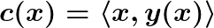
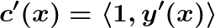
Vessel Linearization (Tangent Vector Estimation)
MATLAB
Pre
processing
Fit a Parametrized Curve c(t) for each Centerpoint
Define “Principal Direction” of vessel as “the direction (x,y,z) in which the vessel progresses the most”
Fit 2 polynomials (degree decided by user), where each “Dependent” coordinate is a function of the “Principle Direction” coordinate
Curve is fit with n points before and after centerpoint (total # of points = 2n+1)
Take Derivatives of Parametrized Curves and Evaluate Derivatives at Centerpoint
The resulting vectors are the estimated tangent vectors ( )
2D Example where “Principal Direction” is in x direction (t = x):

Slide 14
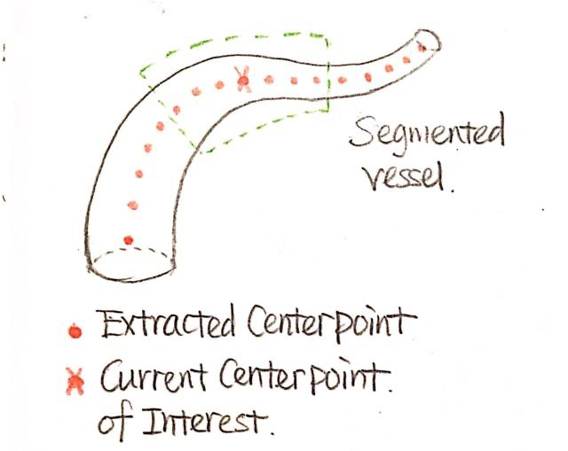
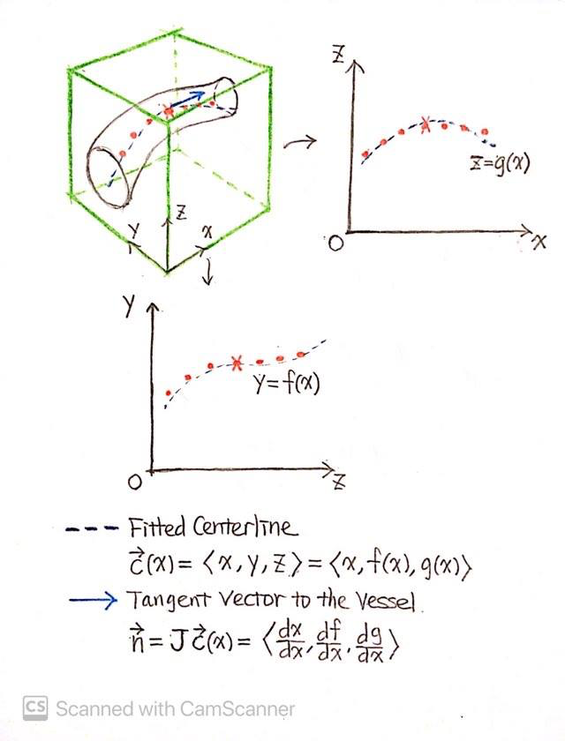
Vessel Linearization (Tangent Vector Estimation)
MATLAB
Pre
processing

Slide 15
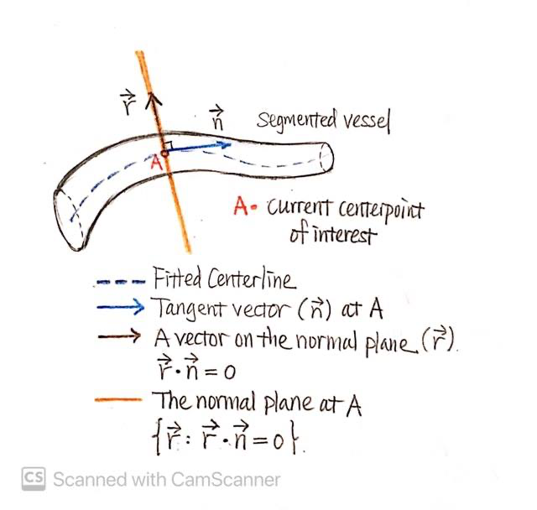
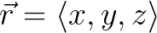
Vessel Linearization (Normal Plane Calculation)
Pre
processing
MATLAB
Estimated Tangent Vectors are Actually Normal Vectors for our Normal Planes
Planes will be 31x31 pixels (~10.5x10.5 mm)
Calculate Coordinates for Normal Plane using the following equation:
Where &
Stack Individual Normal Planes to obtain Linearized Vessel
A set to (0, 0, 0) in this drawing

Slide 16
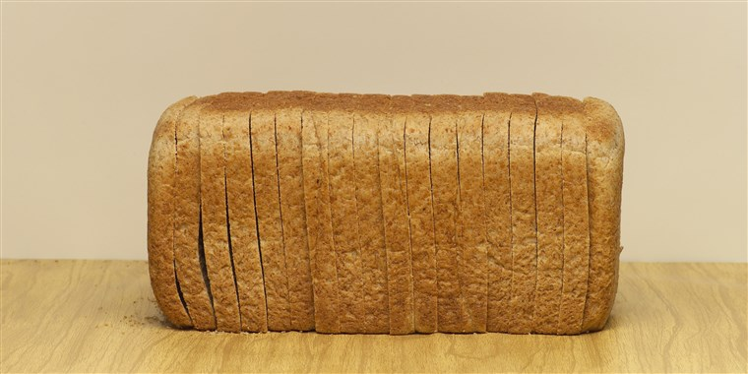
Vessel Linearization (Normal Plane Calculation)
Pre
processing
MATLAB
Estimated Tangent Vectors are Actually Normal Vectors for our Normal Planes
Planes will be 31x31 pixels (~10.5x10.5 mm)
Calculate Coordinates for Normal Plane using the following equation:
Where &
Stack Individual Normal Planes to obtain Linearized Vessel
We can think of each Normal Plane as a slice of bread. The Linearized Vessel would then be a loaf of bread.

Slide 17
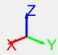
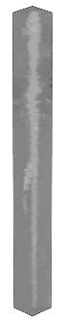
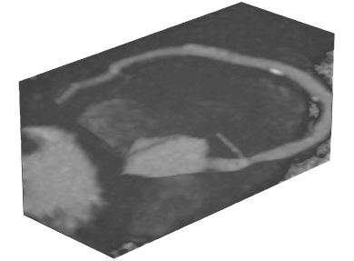
Vessel Linearization
Pre
processing
MATLAB
Nonlinearized Vessel
Linearized Vessel

Slide 18
Tissue Characterization
MATLAB
processing
Motivation:
Quantitatively characterize different tissues using pixel brightness in Hounsfield Units (HU)
Present results in a visual manner
MATLAB Tools for Colored Visualization of an Image:
ColorMaps
Assigns specific colors to specific numerical values
Many ColorMaps are already built into MATLAB
Labels
Assigns Numerical Labels to specific numerical values
Labels can be used for quantitative downstream analysis
Tissue Type | HU Range | ColorMap Color | Numerical Label
Blood (Contrast Agent) | 650 to 985 | Red | 1
Vessel Lining | 277 to 600 | Blue | 2
Myocardium | -70 to 10 | Yellow | 3
Epicardial Fat | -148 to -70 | Purple | 4
Calcium | 1000+ | Green | 5

Slide 19

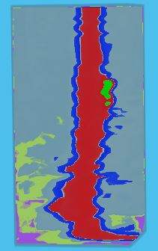
Tissue Characterization (ColorMap)
MATLAB
processing
Red - Blood (Contrast Agent)
Blue - Vessel Lining
Yellow - Myocardium
Purple - Epicardial Fat
Green - Calcium
Linearized Vessel With Gray ColorMap
Linearized Vessel With Custom
ColorMap

Slide 20
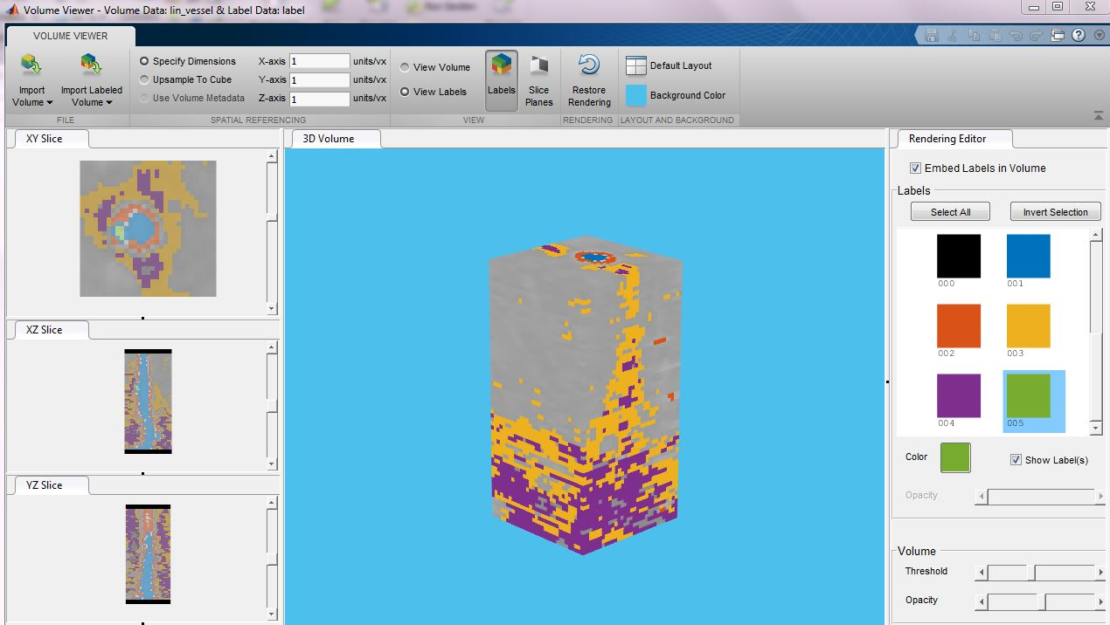
Tissue Characterization (Label)
processing
MATLAB

Slide 21
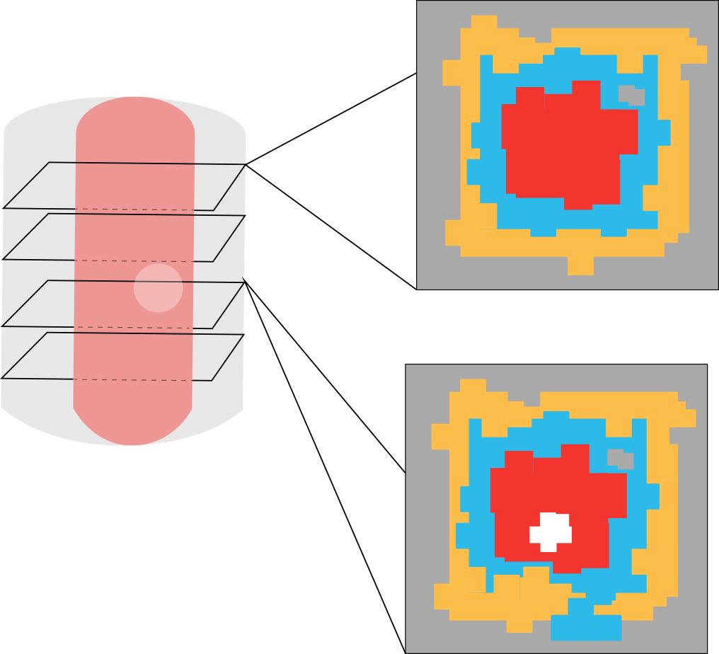


Probability Distribution Analysis
MATLAB
processing
Muscle
pix.count/totalpix.
Label | %
Calcium | 0.092
Vessel Lining | 0.09
Epicardium | 40.587
Epicardial Fat | 35.527
Connective Tissue | 23.612
Vessel
Calcium
Fat
1
Pick slices of linearized vessel
2
Identify vessel
Identify tissue type outside vessel
Identify Calcium
Obtain % Distribution of tissue type around the vessel based on pixel distinction.
3

Slide 22
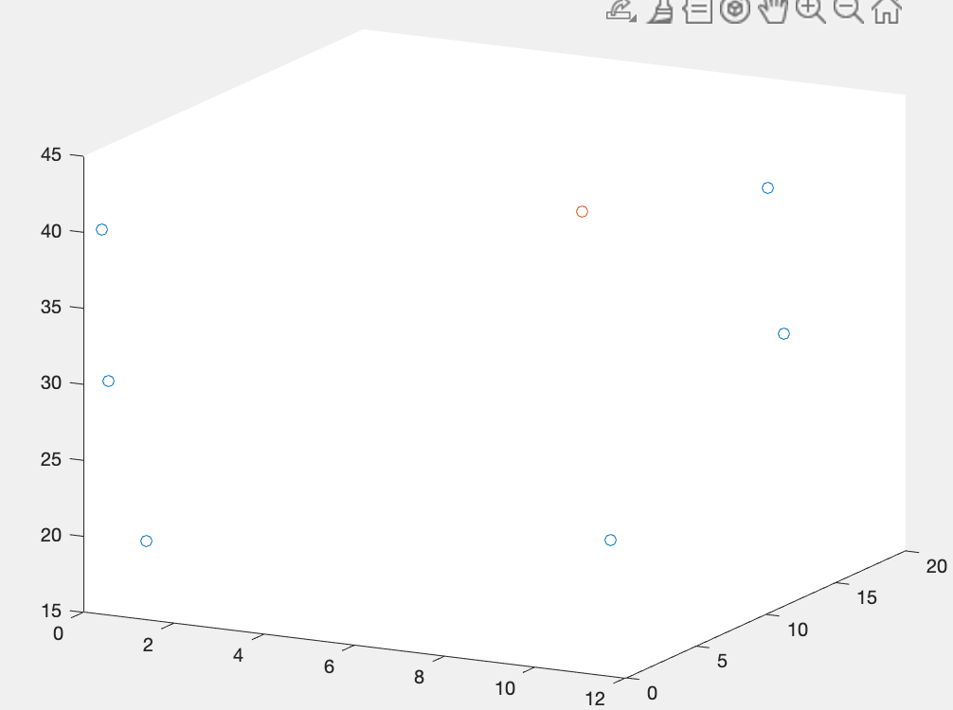
Center of Mass
MATLAB
processing
Label | X | Y | Z
Calcium | 9.6923 | 4.3654 | 43
Vessel Lining | 9.6154 | 10.731 | 18.346
Epicardium | 9.684 | 11.238 | 40.112
Epicardial Fat | 12.533 | 11.279 | 30.101
Based off ct_label function: to create a binary matrix for each tissue type.
Formula for Binary Center of Mass: Mean value across x,y,z coordinates.
Goes across all x,y,z positions in the 3D Matrix
Across all z-slices
<x, y, z>
Ca lesion
Vessel Lining
Center of Mass Calcium
Distance to surrounding tissues
Label from Calcium | Min Distance | Max Distance
Vessel Lining | 8.8239 mm | 35.5839
Epicardium | 4.3050 mm | 57.7569
Epicardial Fat | 1.431 mm | 57.1848
Epicardial Fat
Epicardium

Slide 23
Design Re-cap: Features
Calculate Distribution of tissue around vessels with and without calcium
Visualize in 3D different tissues and calcium
Calculate max. & min. Projected distance from lesion to different tissues
Identify Tissue Types in each layer
Extract Vessel
Linearize Vessels
Extract 3D location of centroid of each tissue type and calcium
ITK-SNAP
MATLAB

Slide 24
Quantifying Analysis
Possible new frontier of cardiovascular research
E.g. shortest distance between lesion and fat tissue
Discover possible links between atherosclerosis and the transport of external pathological agent
Distance Measurements
E.g. relative location of different types of tissue More detailed investigation of the sites specificity of atherosclerosis
Center of Mass Locations
E.g. relative location of different types of tissue
Discover correlations between atherosclerosis and the tissue surrounding the vessel
Distribution of Tissue

Slide 25
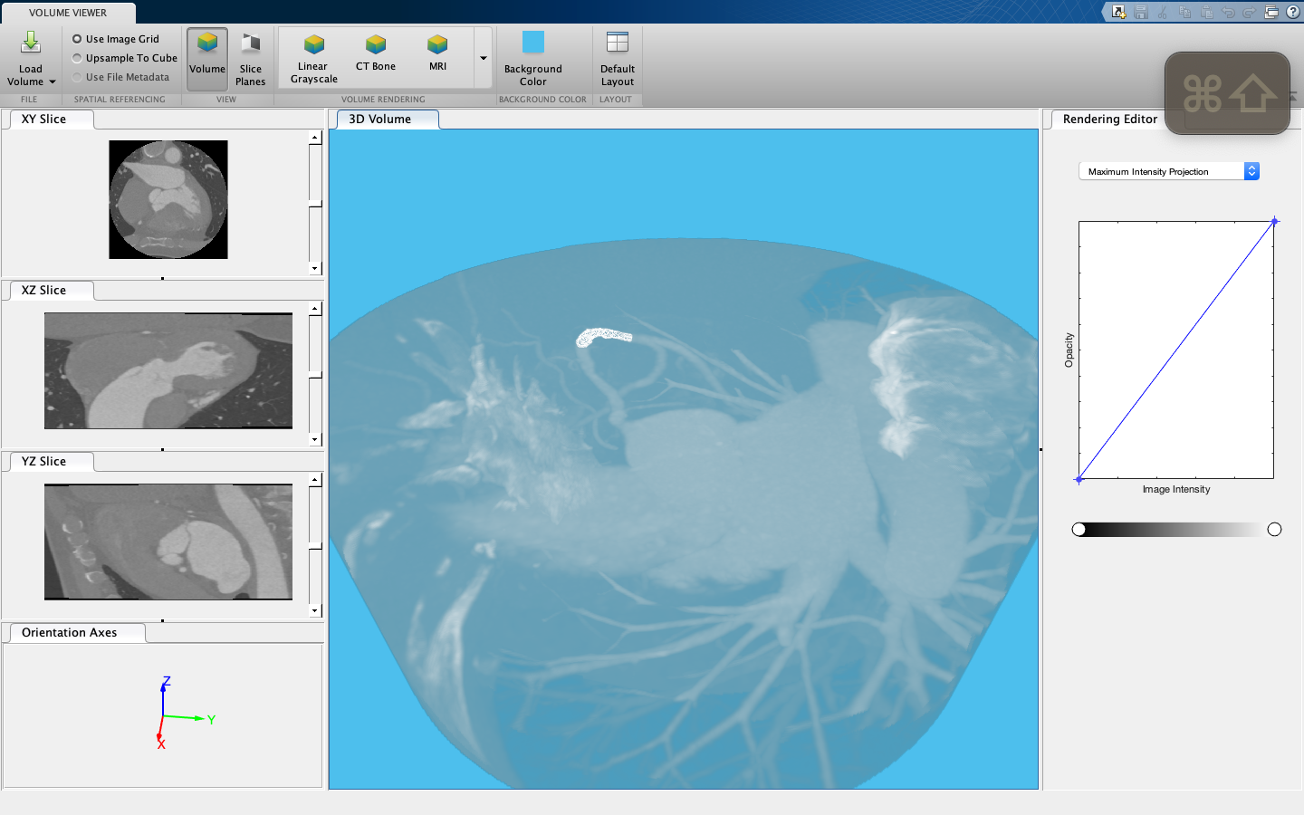
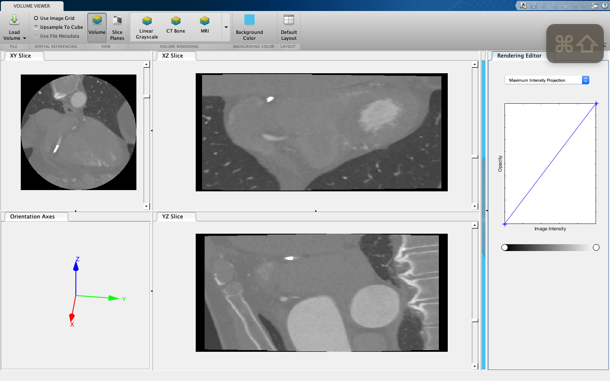
Results and Discussion
1. Robust integration between ITK-SNAP and MATLAB
Overlaying ITK-SNAP output with CT image recovers vessel location
The two platforms integrates well

Slide 26
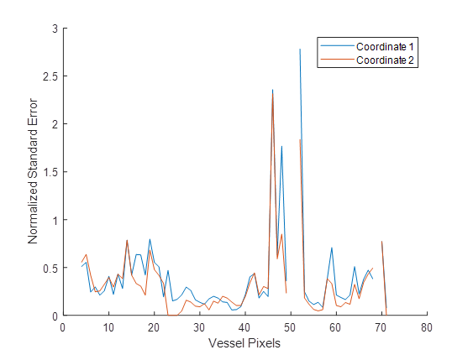
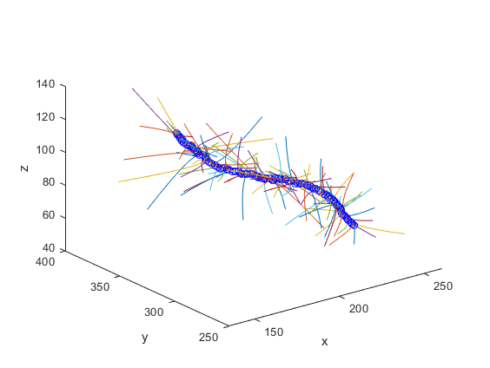
Results and Discussion
2. Adequately accurate centerline parameterization
3rd degree polynomials fitted to every 7 consecutive center points
Normalized Standard Error:
4 • Standard Error / Vessel Diameter
4 • Standard Error = 95% prediction interval
Opportunities for improvement:
Centerline extraction accuracy
Optimize fitting protocol

Slide 27
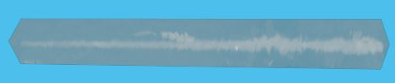
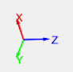
Results and Discussion
3. A limitation of vessel linearization resolved
A major caveat of vessel linearization: bifurcated vessel cannot be linearized
Branches of a bifurcated vessel segmented and linearized separately
However, informations regarding the bifurcation is not lost
Captured with other tissues in the normal planes of the vessel

Slide 28
Results and Discussion
4. Tissue characterization may need further testing and optimization
Verified with visual inspection
Qualitative
Time consuming
Inaccurate
Further testing: Verify current tissue characterization results against expert recommendations
Quantified statistical analysis

Slide 29
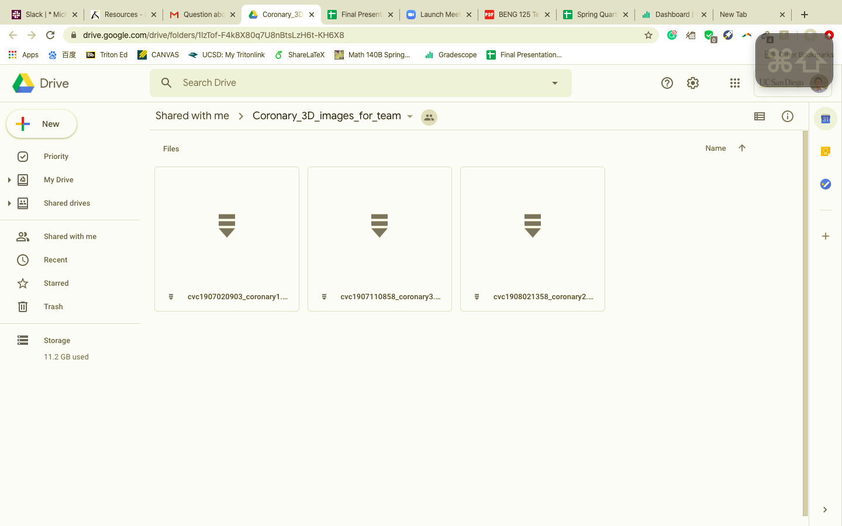
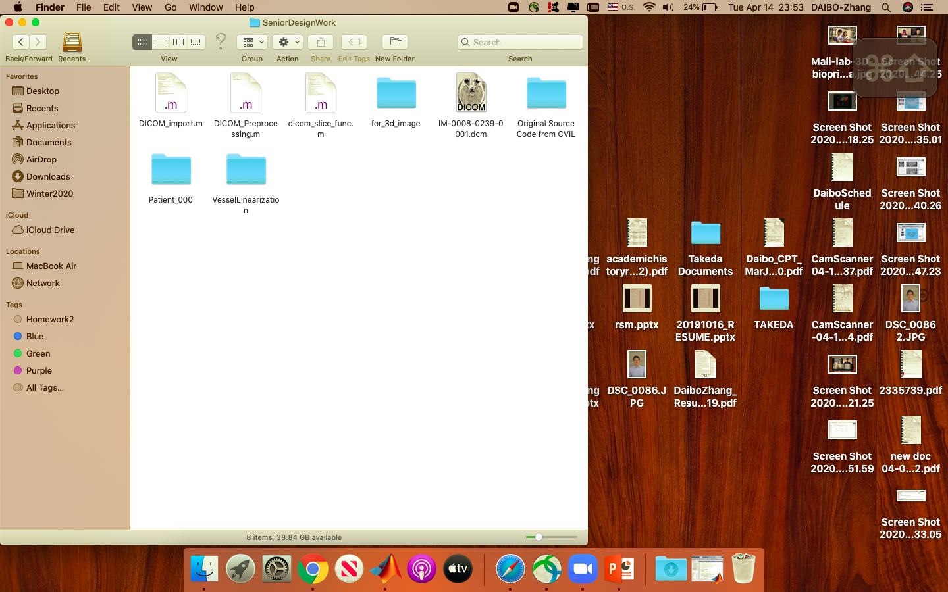
Ethical Considerations
Patient Confidentiality
Patient consent to research use
De-identified Images
Patient information not required or inferred
Using phantoms for future testing

Slide 30
Conclusions
Further understanding of atherosclerosis requires an analysis of tissue surrounding the coronary artery
We constructed a pipeline that lays the foundation for such studies
Vessel linearization and tissue characterization
The pipeline attains a proof of concept
Vessel linearization algorithms are proven acceptable robust
Linearized vessels can be more intuitively visualized and analyzed
Possibilities for tissue analysis is immense
More effort is required before the pipeline is ready for deployment
More systematic analysis packages
More intelligent tissue characterization techniques
Better user experience and higher throughput

Slide 31
Future Directions
Next Few Month
Next Year
Eventual Goal
Further test the pipeline with additional vessels from different images
Better integrate different components of the pipeline
Improve tissue analysis modules
Documentation
Improve user interface design and user experience
Adding more tissue analysis modules
Beta testing
Begin physiologically relevant studies with additional images
Improve the throughput of the pipeline (automation and software engineering)
Continue physiologically relevant studies with a large number of images
Generate new insights into the pathology of atherosclerosis

Slide 32
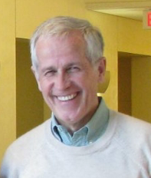
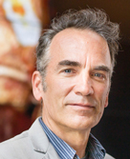


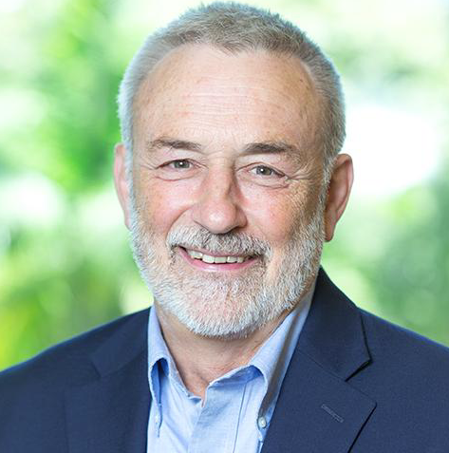
Acknowledgements
For their technical guidance
Dr. Geert Schmid-Schönbein
Dr. Elliot McVeigh
Zhennong Chen
For their professional support
Neha Chhugani
Dr. Bruce Wheeler

Slide 33
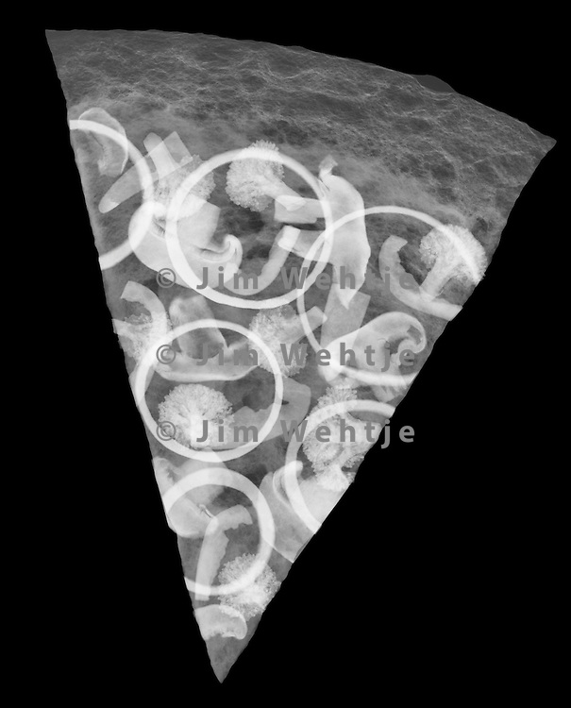



THANK YOU!
ANY QUESTIONS?

